Slide 1
3 Axis Pin Development Update
Week #1

Slide 2
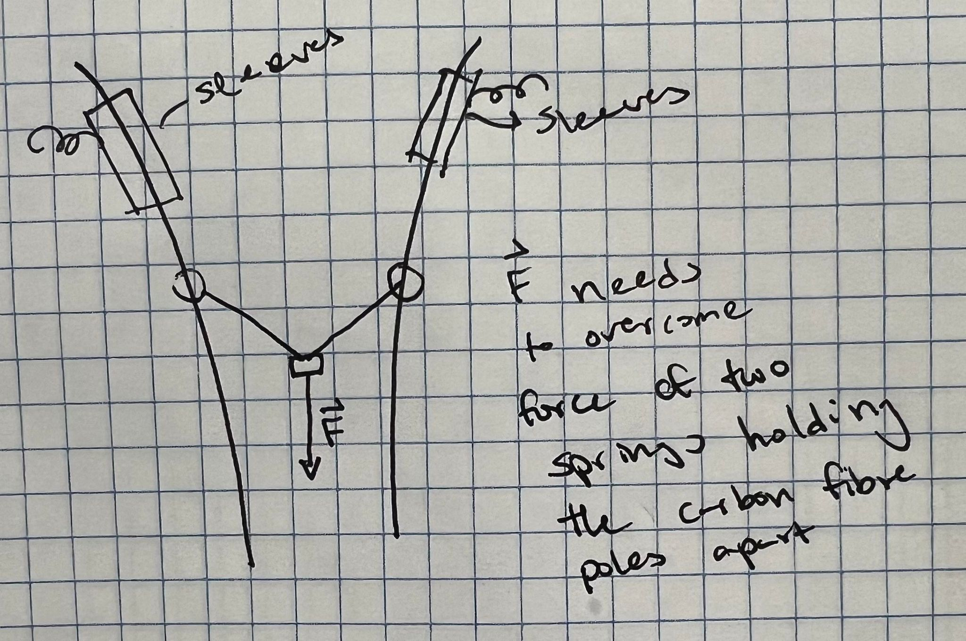
Idea

Slide 3
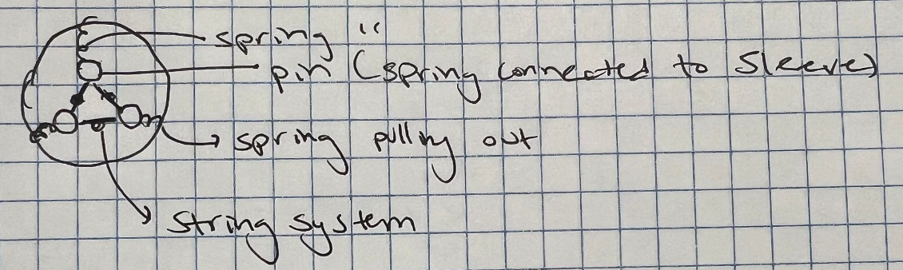
Step 1 - Model 3 pin array

Slide 4
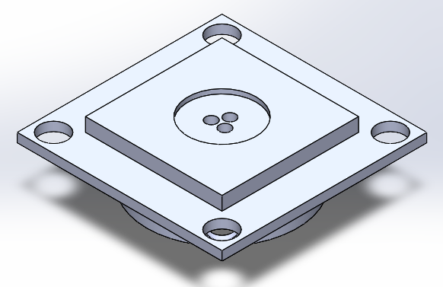

Slide 5

Demonstration 1:

Slide 6
Current Plans
Motor clutch system
Sprag Bearings?
Definite number of motors required form n sided hex array
Fix vertical movement of pins due to friction with spring
Fixed mount between sleeves
Experiment with springs
2 springs for each pin?

